Slide 1
MAT386E – Term Project
090190328 – Eren Tümkaya
090190334 - Konuralp Arslan
090190356 – Ahmet Salih Çoskun

Slide 2
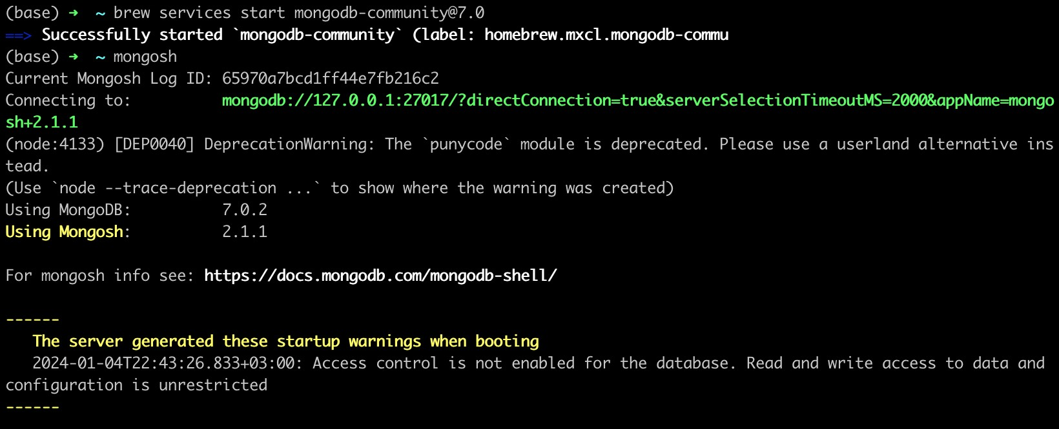

Slide 3
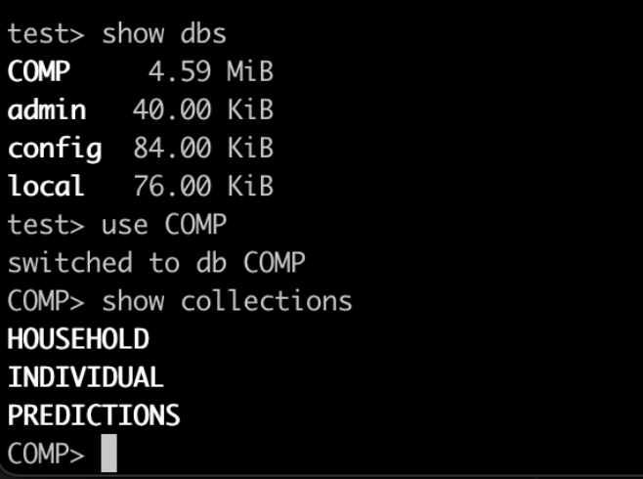

Slide 4
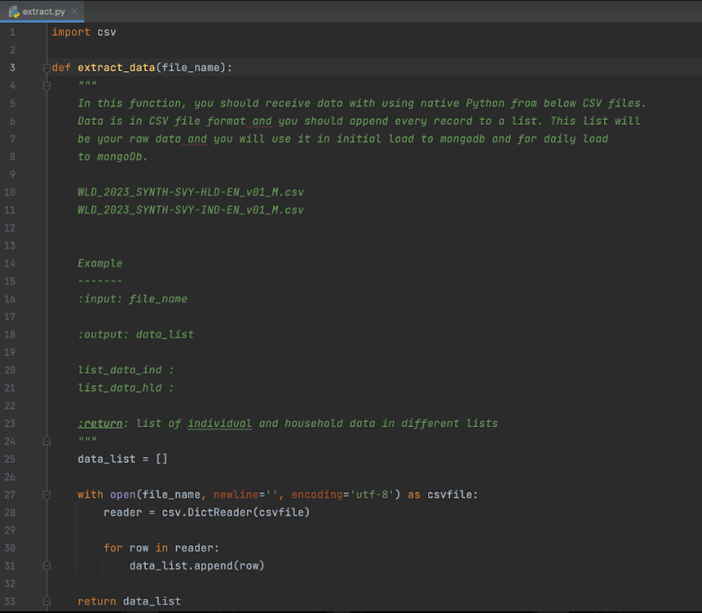

Slide 5
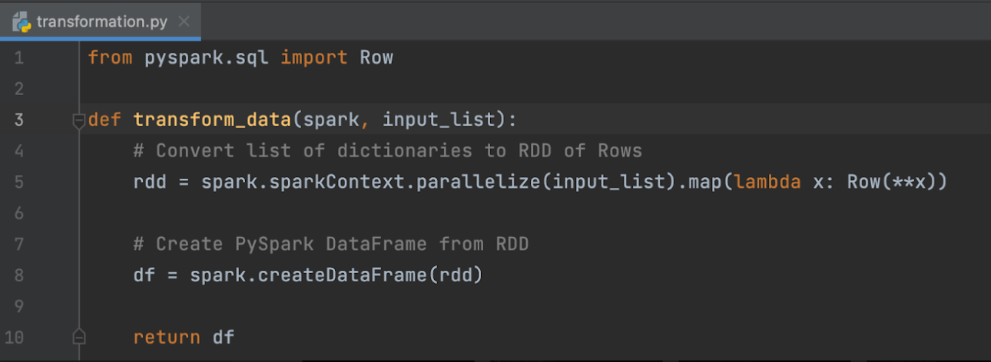

Slide 6
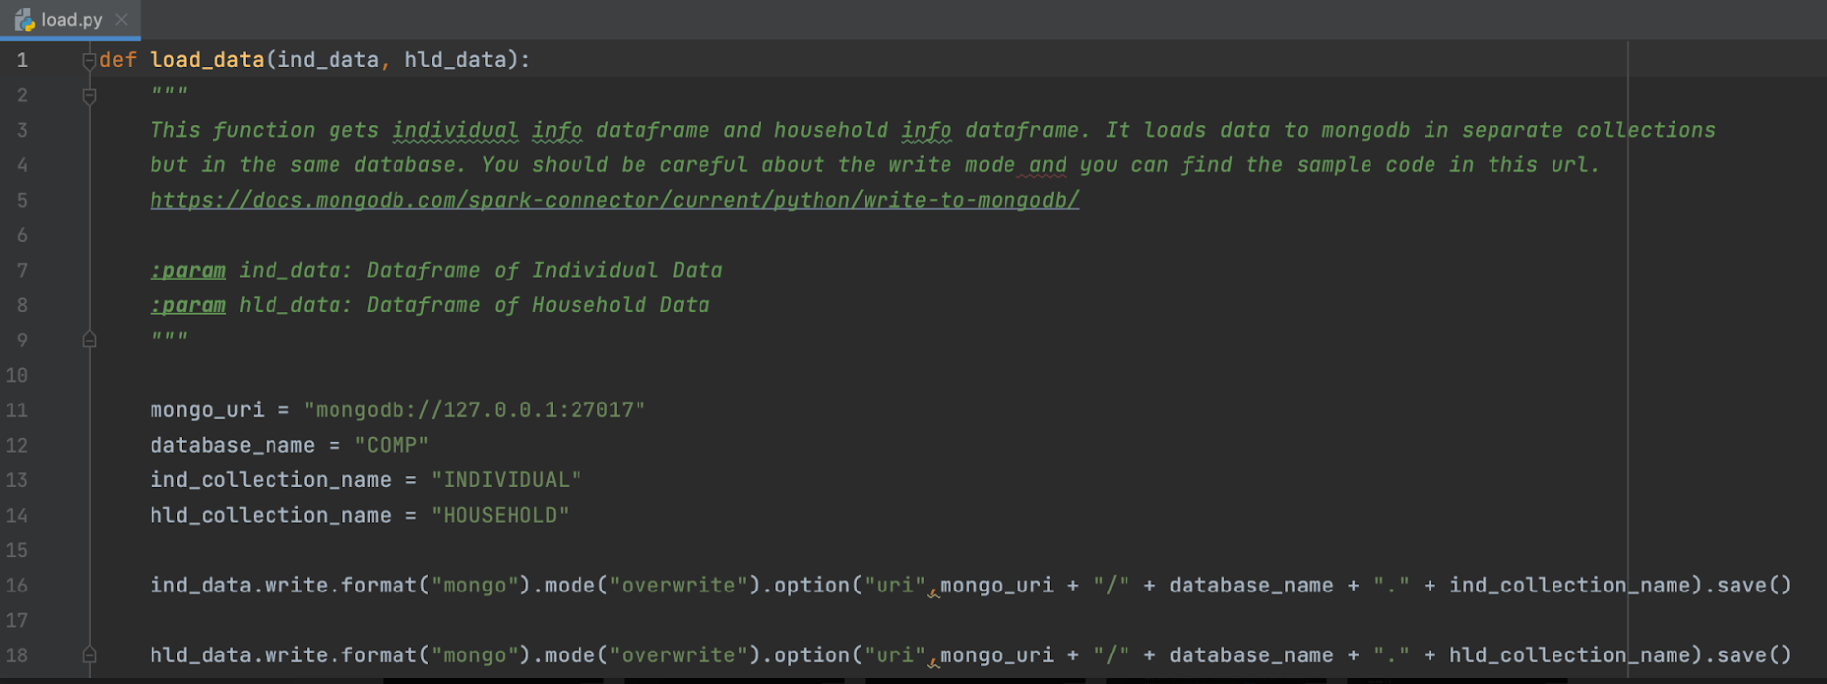

Slide 7
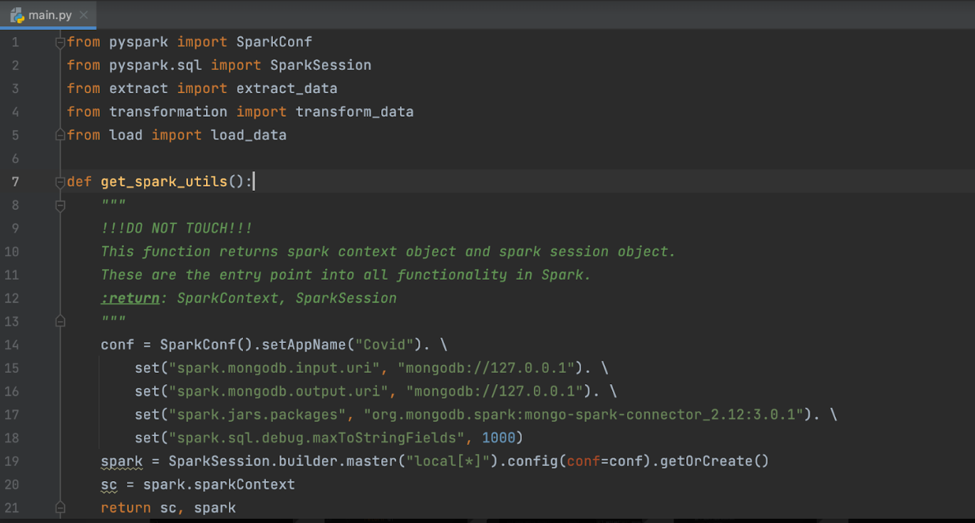

Slide 8
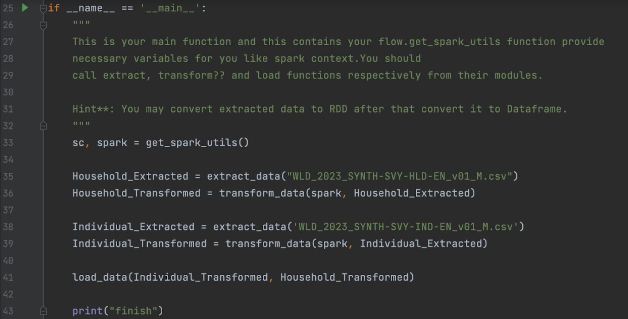

Slide 9
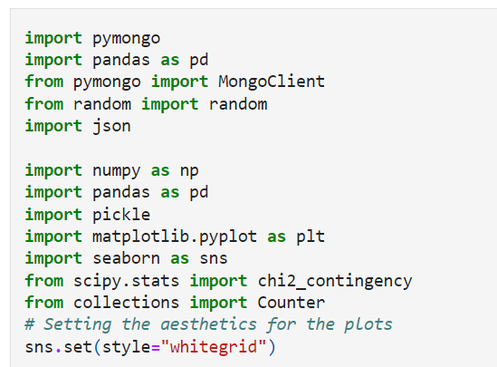
Importing the Required Modules

Slide 10
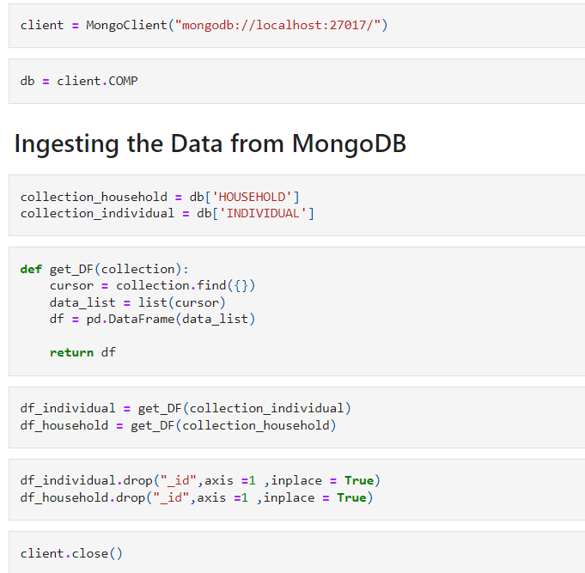

Slide 11
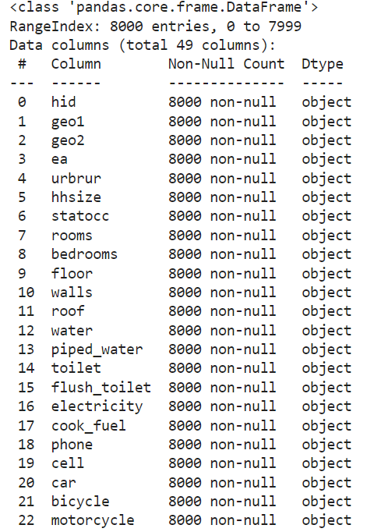
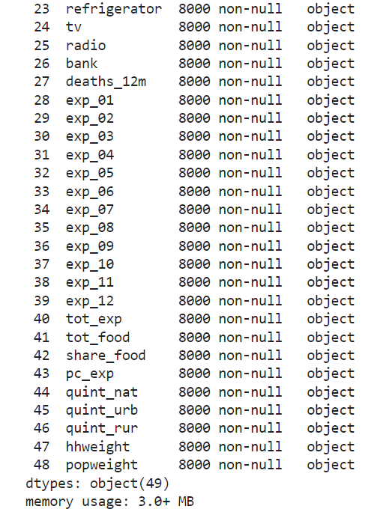
Household Dataset

Slide 12
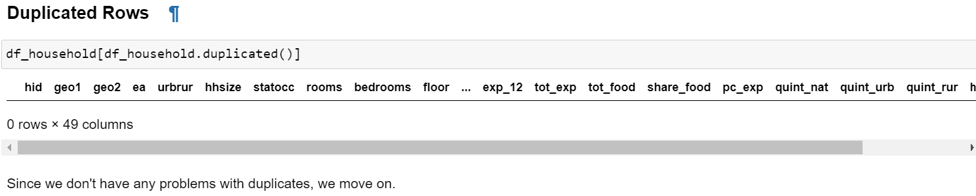
Initial Operations - Duplicated

Slide 13
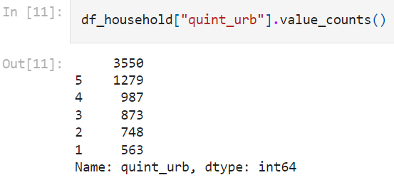
Initial Operations – Missing Data- A Surprise

Slide 14
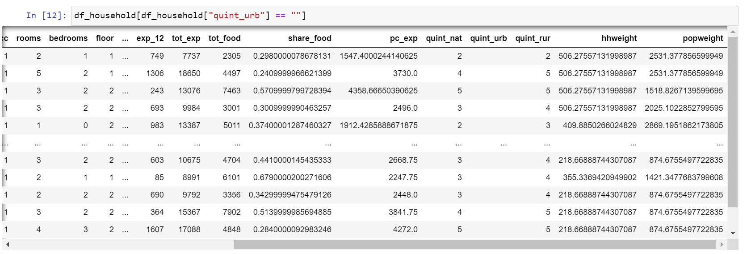
Missing Data – The Reason Why

Slide 15
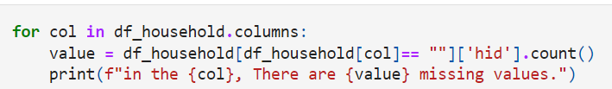
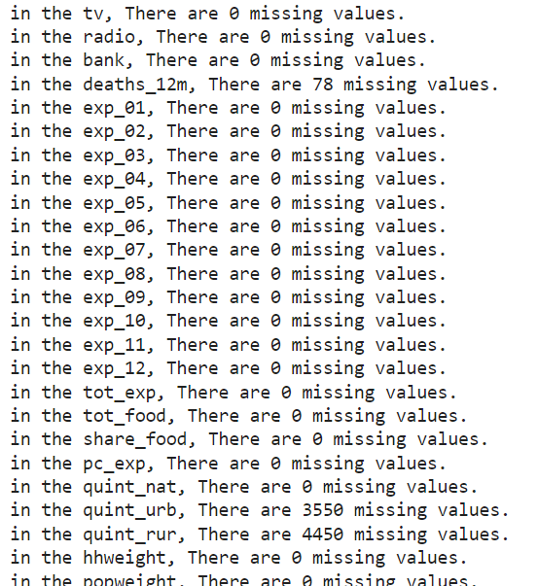
How We Handled

Slide 16
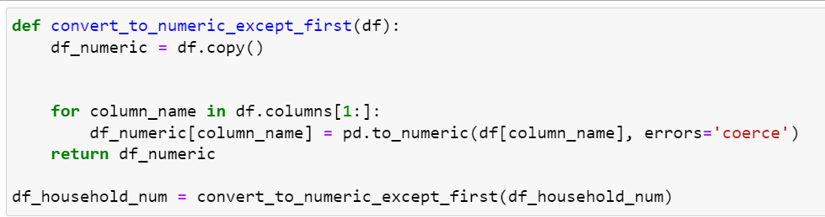
Splitting to Numerical and Categorical
Numeric Ones
Data Type Conversion

Slide 17
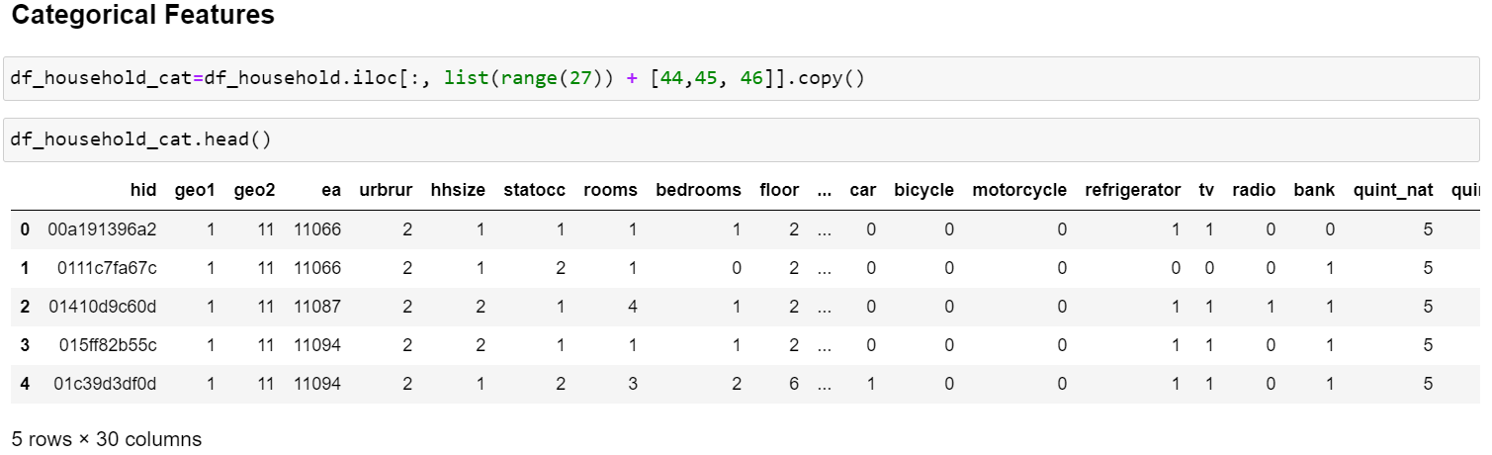
Doing the Same for Categorical Ones

Slide 18
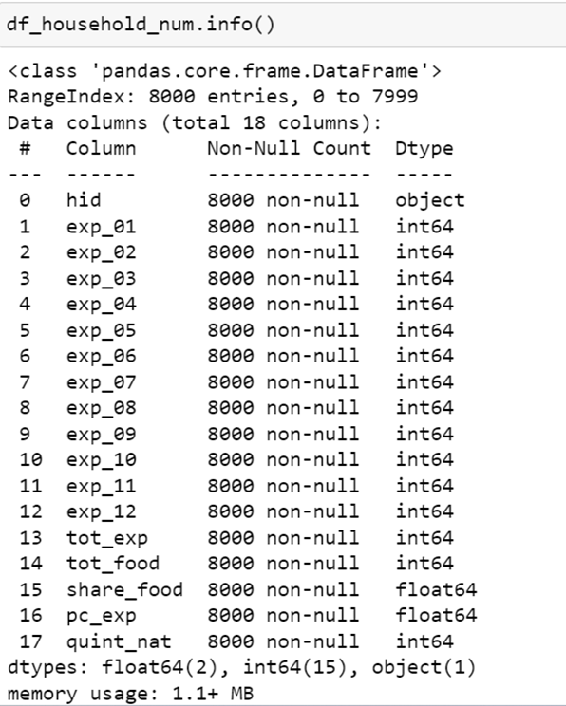
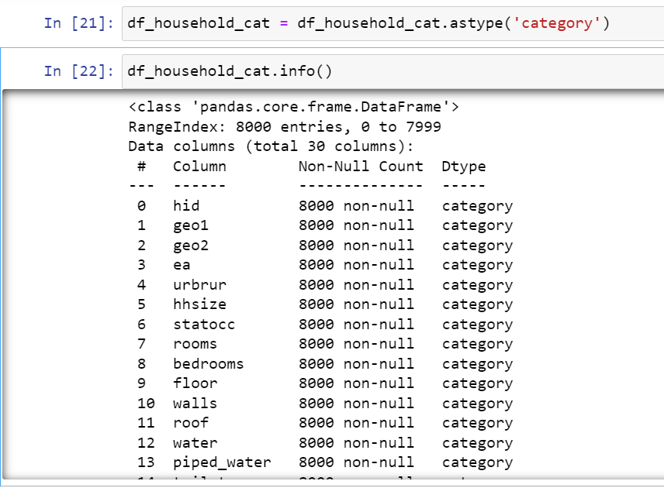
Transformed Frames

Slide 19
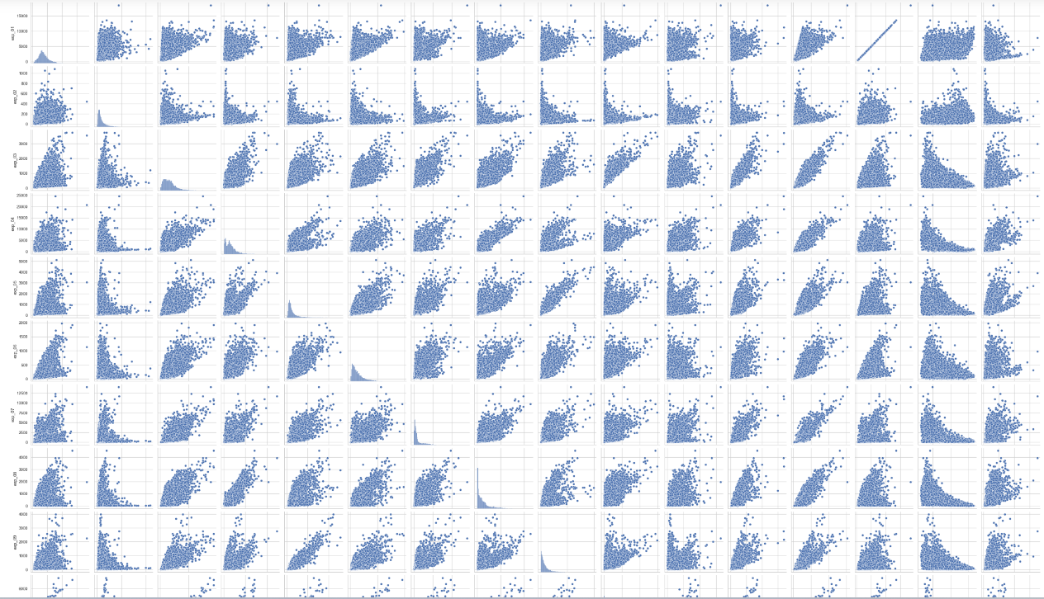
Pair-plots for the Numerical Frame

Slide 20
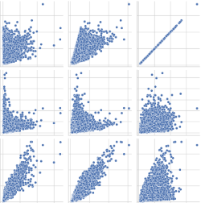
A Closer Look

Slide 21
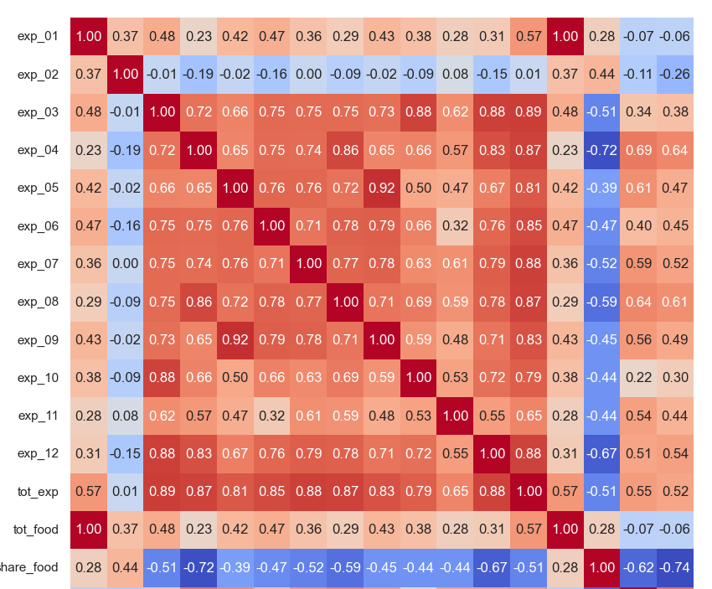
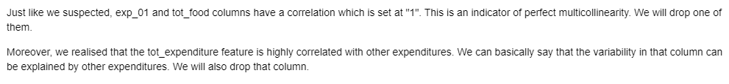
Correlation Matrix

Slide 22
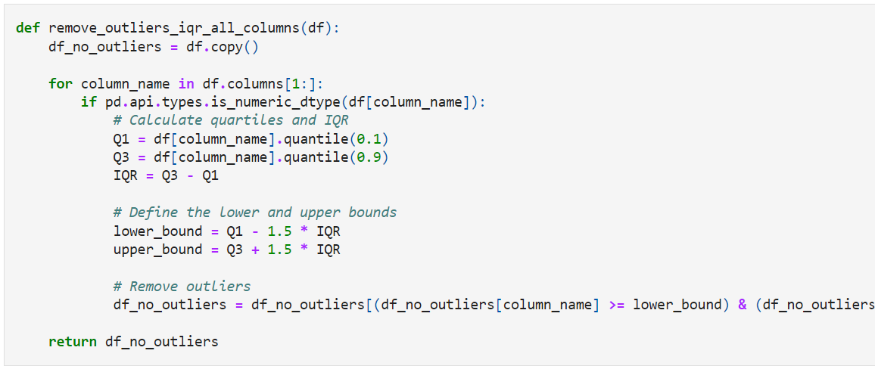
Outlier Removal for Numeric Columns

Slide 23
Statistical Analysis for the Categorical Frame

Slide 24
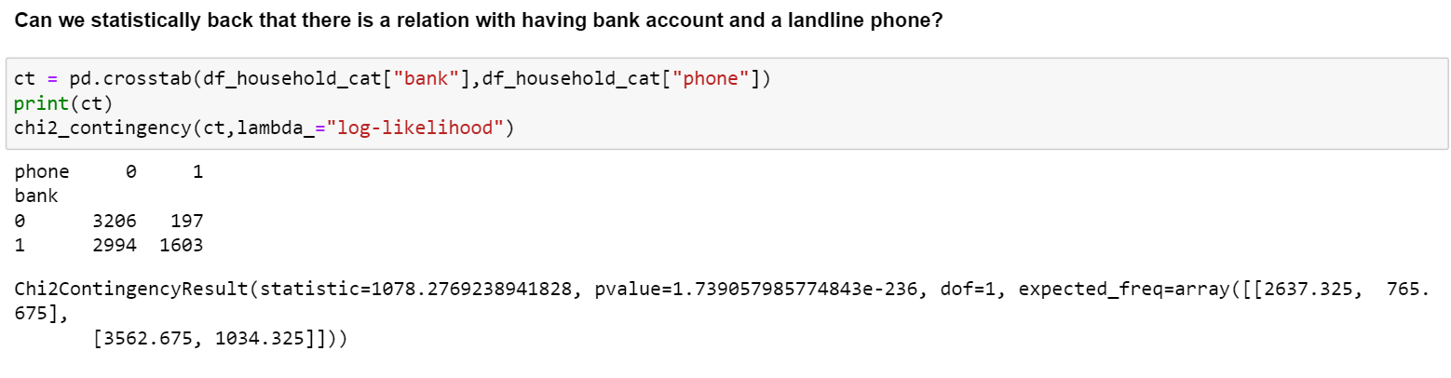
Landline Phone and Bank Account

Slide 25
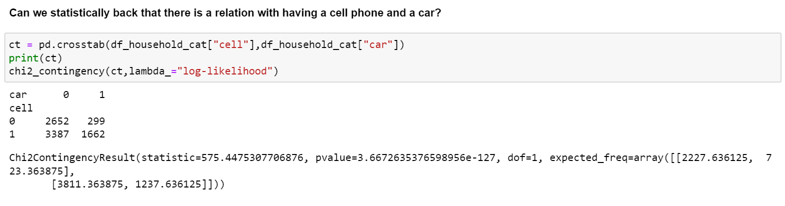
Cell Phone and a Car

Slide 26
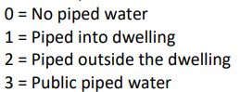
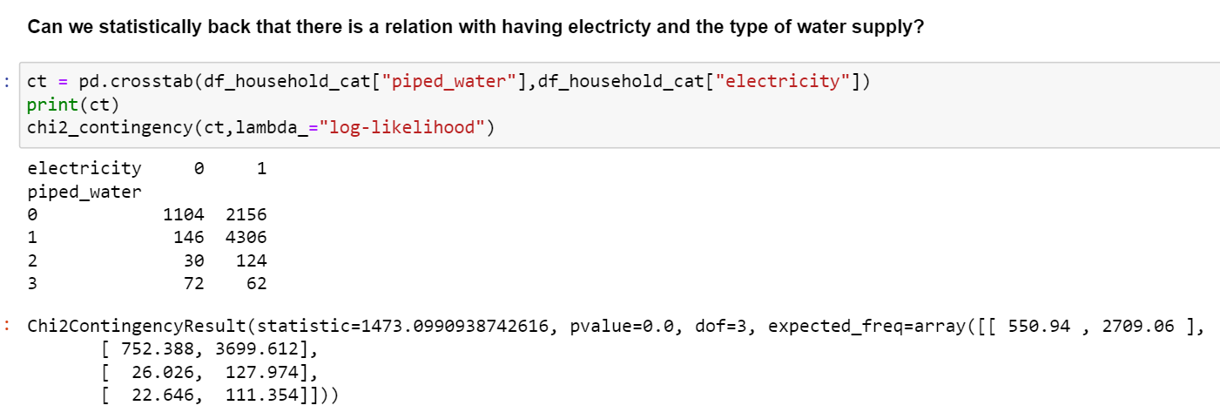
Electricity and the Type of Water Supply

Slide 27
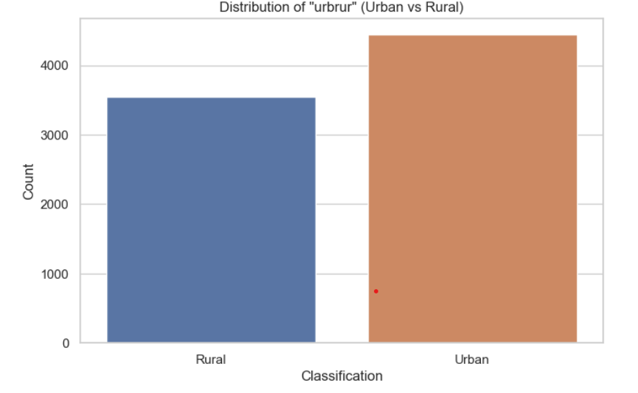
Target Analysis

Slide 28
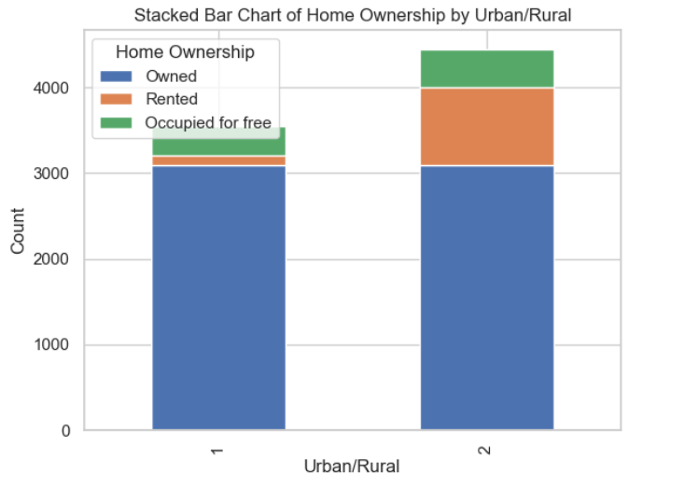

Slide 29
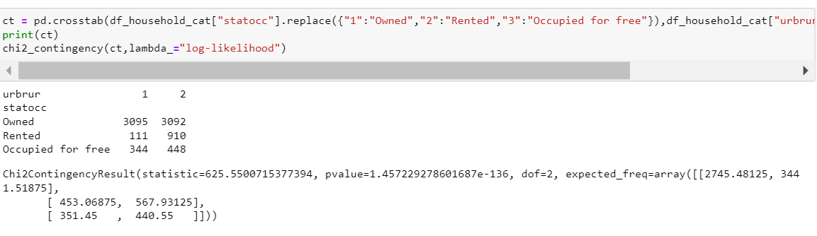

Slide 30
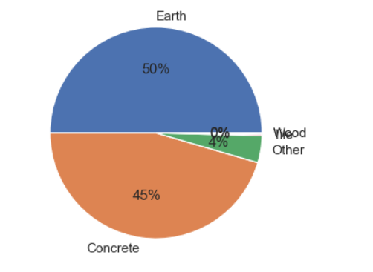
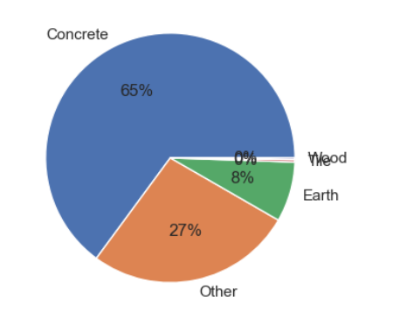
Distribution of Floor Types? Which one?

Slide 31
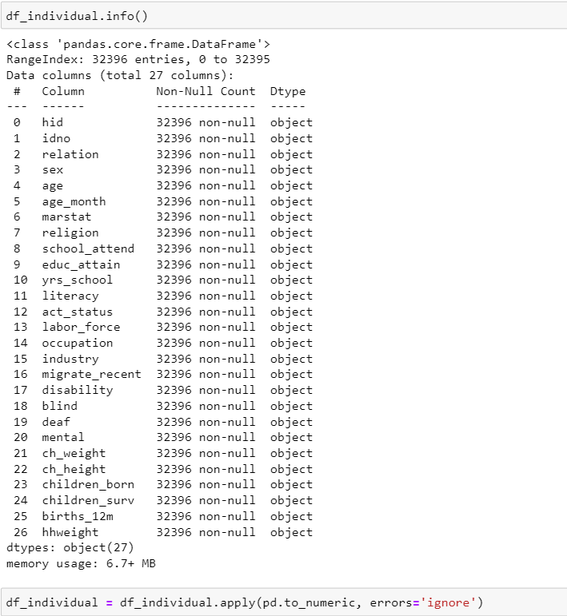
Individual Dataset

Slide 32
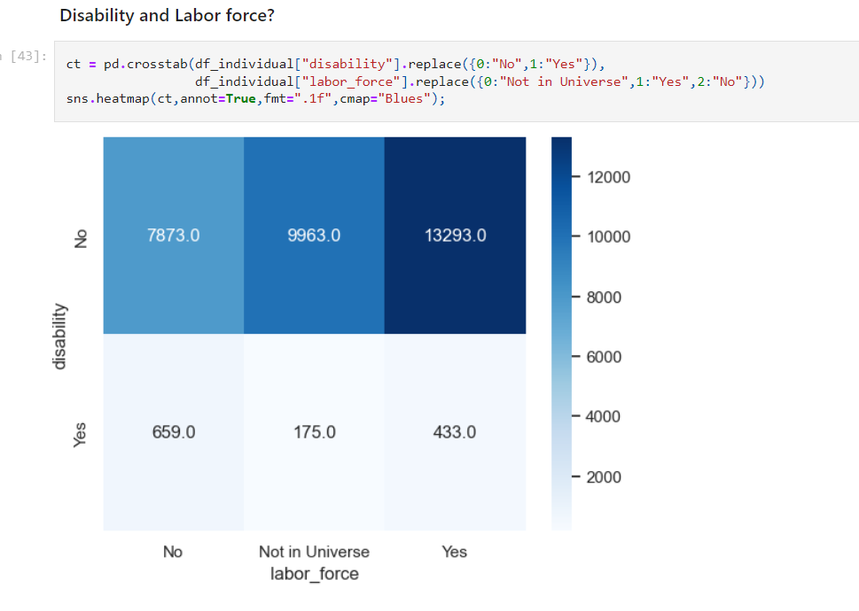

Slide 33
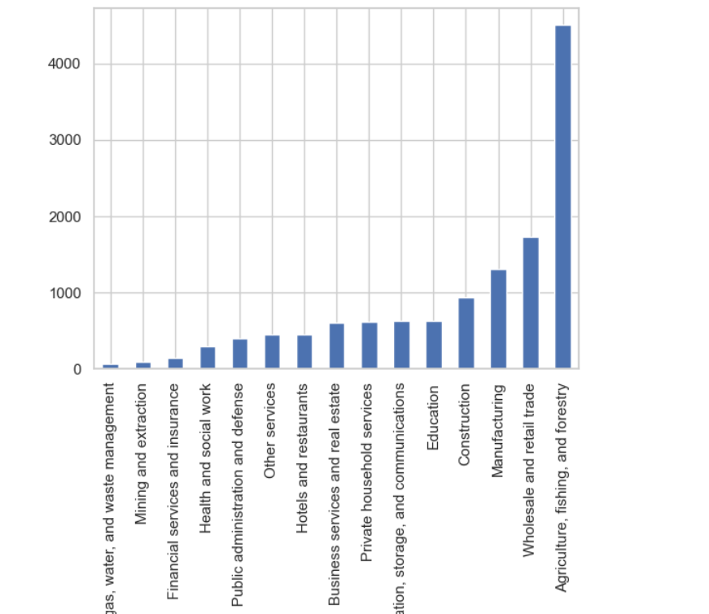
Individual Industry

Slide 34
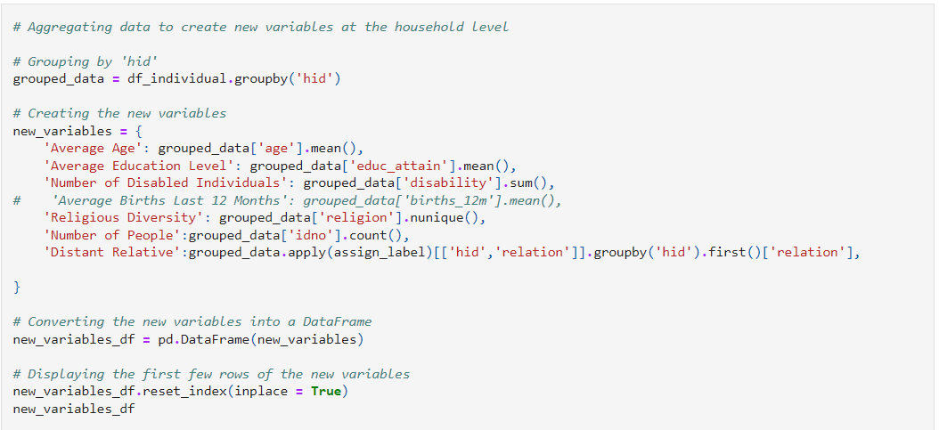
Performing the Grouping

Slide 35
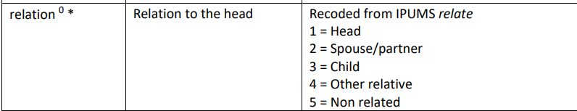
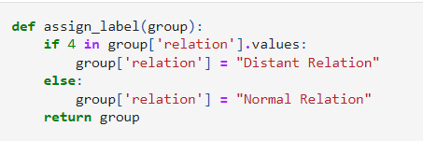
New Features We Added - Relation

Slide 36
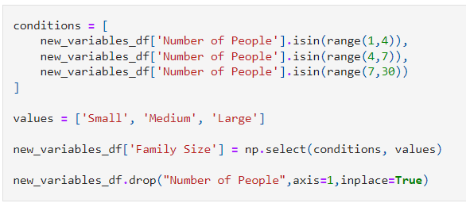
New Feature We Added – Family Size

Slide 37
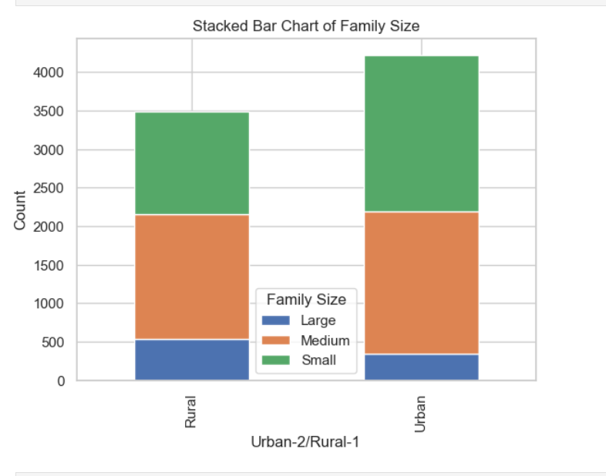

Slide 38
Modeling

Slide 39
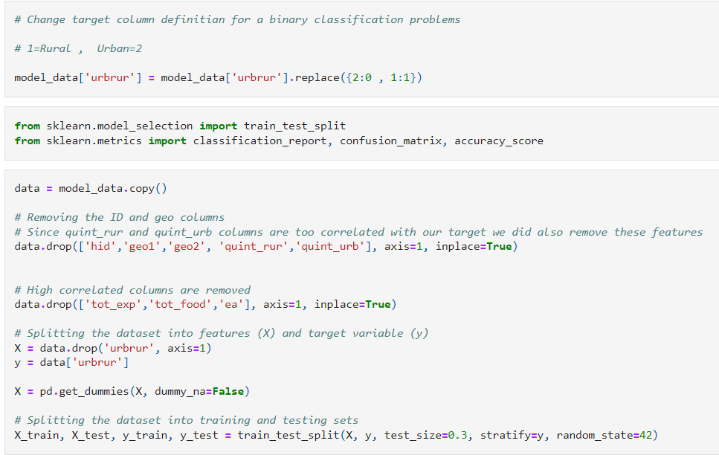

Slide 40
MODEL 1 |  | Tahmin
 |  | 1 | 2
Gerçek | 1 | 890 | 157
 | 2 | 122 | 1146
1 İçin |  | Tahmin
 |  | 1 | 2
Gerçek | 1 | TP | FN
 | 2 | FP | TN
2 İçin |  | Tahmin
 |  | 1 | 2
Gerçek | 1 | TN | FP
 | 2 | FN | TP
Accuracy
(TP + TN) / (TP + FP + TN + FN)
(890+1146)/(890+157+122+1146)
88%
 | Precision | Recall | Support
 | TP / (TP + FP) | TP / (TP + FN) | TP + FN
1 | 890/(890+122) | 890/(890+157) | 890+157
2 | 1146/(1146+157) | 1146/(1146+122) | 1146+122
Macro Average | (Pre1+Pre2)/2 | (Rec1+Rec2)/2
Weighted Average | ((Pre1*Sup1) + (Pre2*Sup2)) / (Sup1+Sup2) | ((Rec1*Sup1) + (Rec2*Sup2)) / (Sup1+Sup2)
 | Precision | Recall | F1 Score | Support
 | TP/(TP+FP) | TP/(TP+FN) | 2*((Pre*Rec)/(Pre+Rec)) | FN+TP
1 | 88% | 85% | 86% | 1047
2 | 88% | 90% | 89% | 1268
Macro Average | 88% | 88% | 88%
Weighted Average | 88% | 88% | 88%

Slide 41
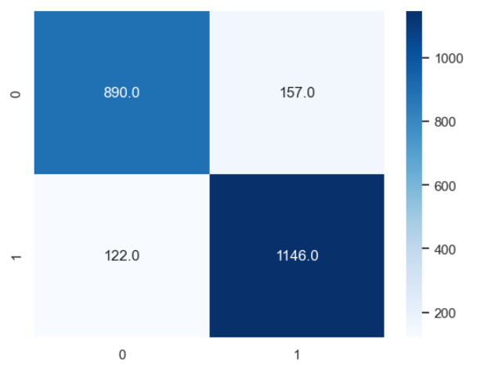
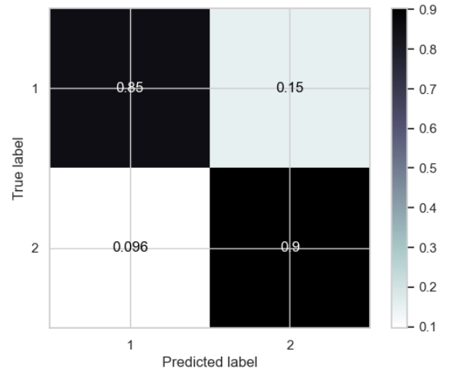
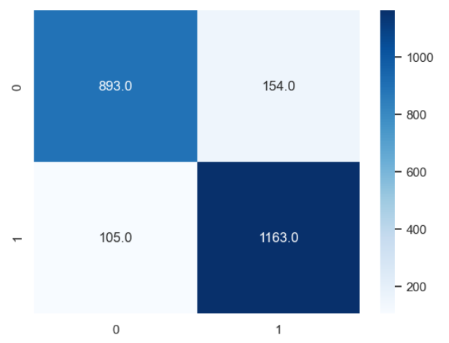
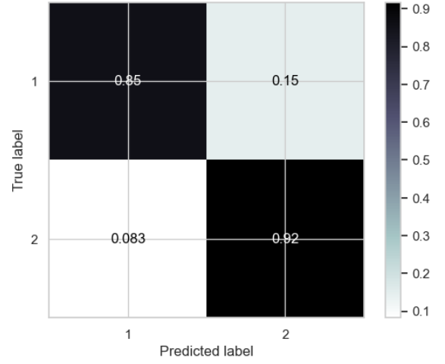
MODEL 1
MODEL 2

Slide 42
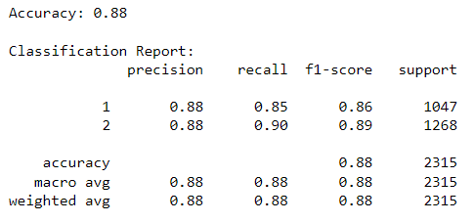
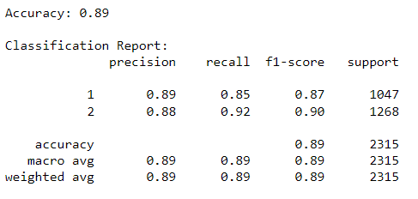
MODEL 1
MODEL 2

Slide 43
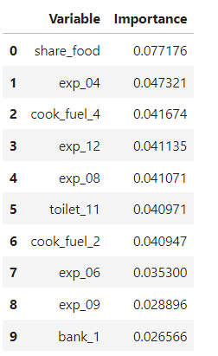

Most Important Features
Model 1 Model 2

Slide 44
Bizi Dinlediğiniz için Teşekkür Ederiz …

